Slide 1
Getting a Handle on your Services with Istio
Prepared by: Christopher M Luciano

Slide 2
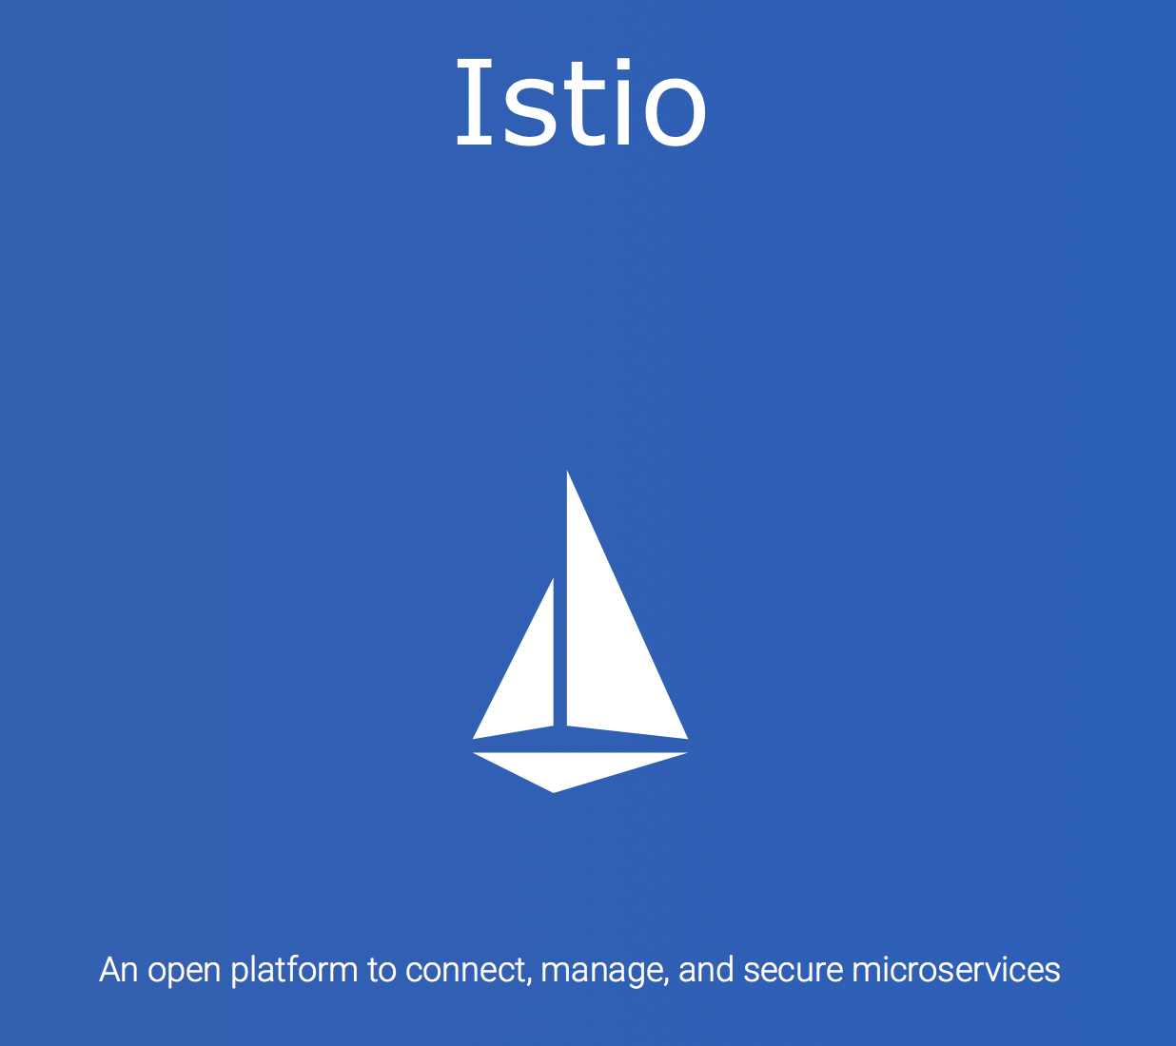
Agenda
Common Production Issues
Basics of Istio
Key Istio features & demos

Slide 3


Building an Application
My Special Application
Users
Developers
Notes:
We start with our simple application to solve our business needs
This application has no dependencies and we only have a few developers that know the internals of our application
This application is normally upgraded in place since we have very few users and can handle momentary downtime

Slide 4
Is It Working Production Graphs
Notes:
As we mature and get more users we develop a few graphs for our individual application that we think are relevant to stare at in times of crisis
We have a graph that shows the percentage of time that we think our service is working
We have a graph to show if we think it’s working right now
And we have a random graph that helped in debugging one time but it’s mainly taking up space and we don’t know what the X and Y axis really mean anymore

Slide 5
Failure Recovery
Runbook 32C
Run check_metric.sh
See if check_metric.sh returns anything
Restart server
Runbook 15R
If it is Wednesday and snowing, return to Runbook 16 step 1
Notes:
We’ve now been through a few incidents so we threw a runbook together for our newer employees to use when they need to wake up and debug the service

Slide 6


Single Application Nirvana
Great Success!!!
Hand Crafted in Madagascar
Organic Apple Juice
Notes:
We now feel satisfied with how far we have come
We have semi meaningful graphs for showing when our application is on fire
We have a runbook to throw at the fire to douse the flames
And are users are generally happy so we are making money
Our CEO placed an order for special hand-crafted organic apple juice from Madagascar to fuel our fire dousing abilities

Slide 7
Microservices – Breaking up the Monolith
Service
Service
More traffic
More power
My Special Application
Service
Service
Service
Service
Notes:
We’ve started to split out our services to make the dousing of fires faster
Our test scripts validate that all of the services work independently but we can’t easily prevent outages when a few of our independent services fail

Slide 8
Even more "Is It Working Production Graphs"
Notes:
We start to add more metrics to figure out what services are acting up and are runbook has a few more steps to determine which thing is failing
Unfortunately it’s difficult to test new feature failures with other services because we don’t work on them and we never seem to know how long it takes them to recover or respond
Our metrics also only show individual service health instead of global views of the service chain

Slide 9

Speech Feature Rollout
https://blogs.unity3d.com/2018/02/20/bringing-the-power-of-ai-to-developers-with-the-ibm-watson-unity-sdk/
Notes:
Let's say we are a game developer and we want to enable single players to leverage IBM Watson to communicate with NPCs

Slide 10
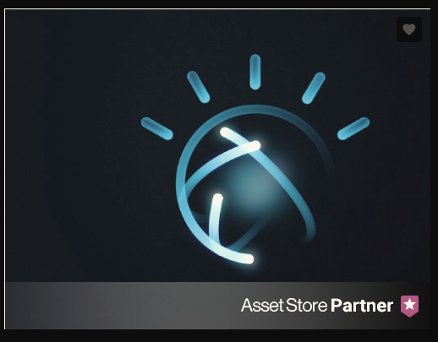
Speech Feature Rollout
https://assetstore.unity.com/packages/tools/ai/ibm-watson-unity-sdk-108831
Notes:
We integrated the Watson-Unity-SDK into our game and now we want a select group of users to leverage our backends for playing with NPCs

Slide 11

Speech Feature Rollout
Notes:
Unfortunately Scott cannot get to the new feature and he was directed to the normal player experience. Now he is stuck switching seats and talking to himself while his ship and NPCs face certain turmoil
We need to be able to direct Scott to the appropriate backend so that he can be an affect ship captain

Slide 12
Notes:
Enter Istio
Istio was developed to help with the day 2 and onward production scenarios that we just reviewed
Istio is deployed in a cluster (k8s or not) as another service. Access to it’s features are controlled the same way Kubernetes allows access to other namespaced services.

Slide 13
A Quick Reminder...
Pods are groups of containers that share resources & lifecycle
Typically, one user-defined container per Pod
Pod
Service
Container
Container
Notes:
Kubernetes will deploy a micro service as a container into a Pod.
Pods are groups of containers that share system resource (namespaces)
E.g. Process, Networking...
Each micro service is deployed into its own Pod

Slide 14
Istio Components

Slide 15
Sidecar?
A secondary container in a Pod
Intercept & manages network traffic
Security/Identity
Pluggability
Shared library for teams
Language Agnostic
Notes:
Istio is able to apply security policies and capture metrics because it communicates through a proxy sidecar
Envoy is an application normally deployed alongside your service like a motorcycle sidecar
This sidecar approach enables developers to rely on Envoy for features that they normally have to build into their application
With Istio you can create security and routing policies and automatically roll them out without stamping out libraries for each service & language
In Kubernetes the Envoy proxy is injected into your deployment spec and runs as another container
As soon as your deployment is scheduled, an iptables rule is created on the host and forever-more all traffic destined for your service is redirected to the Envoy proxy
An istio client library can be used to munge an existing k8s deployment spec before creation or you can deploy the Istio Sidecar-Injector as a Kubernetes mutating webhoook
The mutating webhook is configured to watch a given namespace and automatically inject the Envoy proxy at deployment time

Slide 16
Pod
Pod
Service 1
Service 2
Envoy
Envoy
Pilot
Notes:
Pilot
Pilot asynchronously configures the Envoy sidecar proxy that is embedded within every Kubernetes pod
Pilot populates the Envoy sidecar proxy with service-discovery endpoints and Envoy’s own configuration
Services always talk to each other by first going through the Envoy Proxy

Slide 17
Pod
Pod
Service 1
Service 2
Envoy
Envoy
Pilot
Mixer
Notes:
Mixer
Mixer handles policy enforcement
Most often every request that will go to another service, will first go through Mixer for precondition checks like quota
After the request, Mixer is then called again to report telemetry data
Calls to Mixer are typically buffered for telemetry data such that Mixer only needs to be updated every 1k or so requests

Slide 18
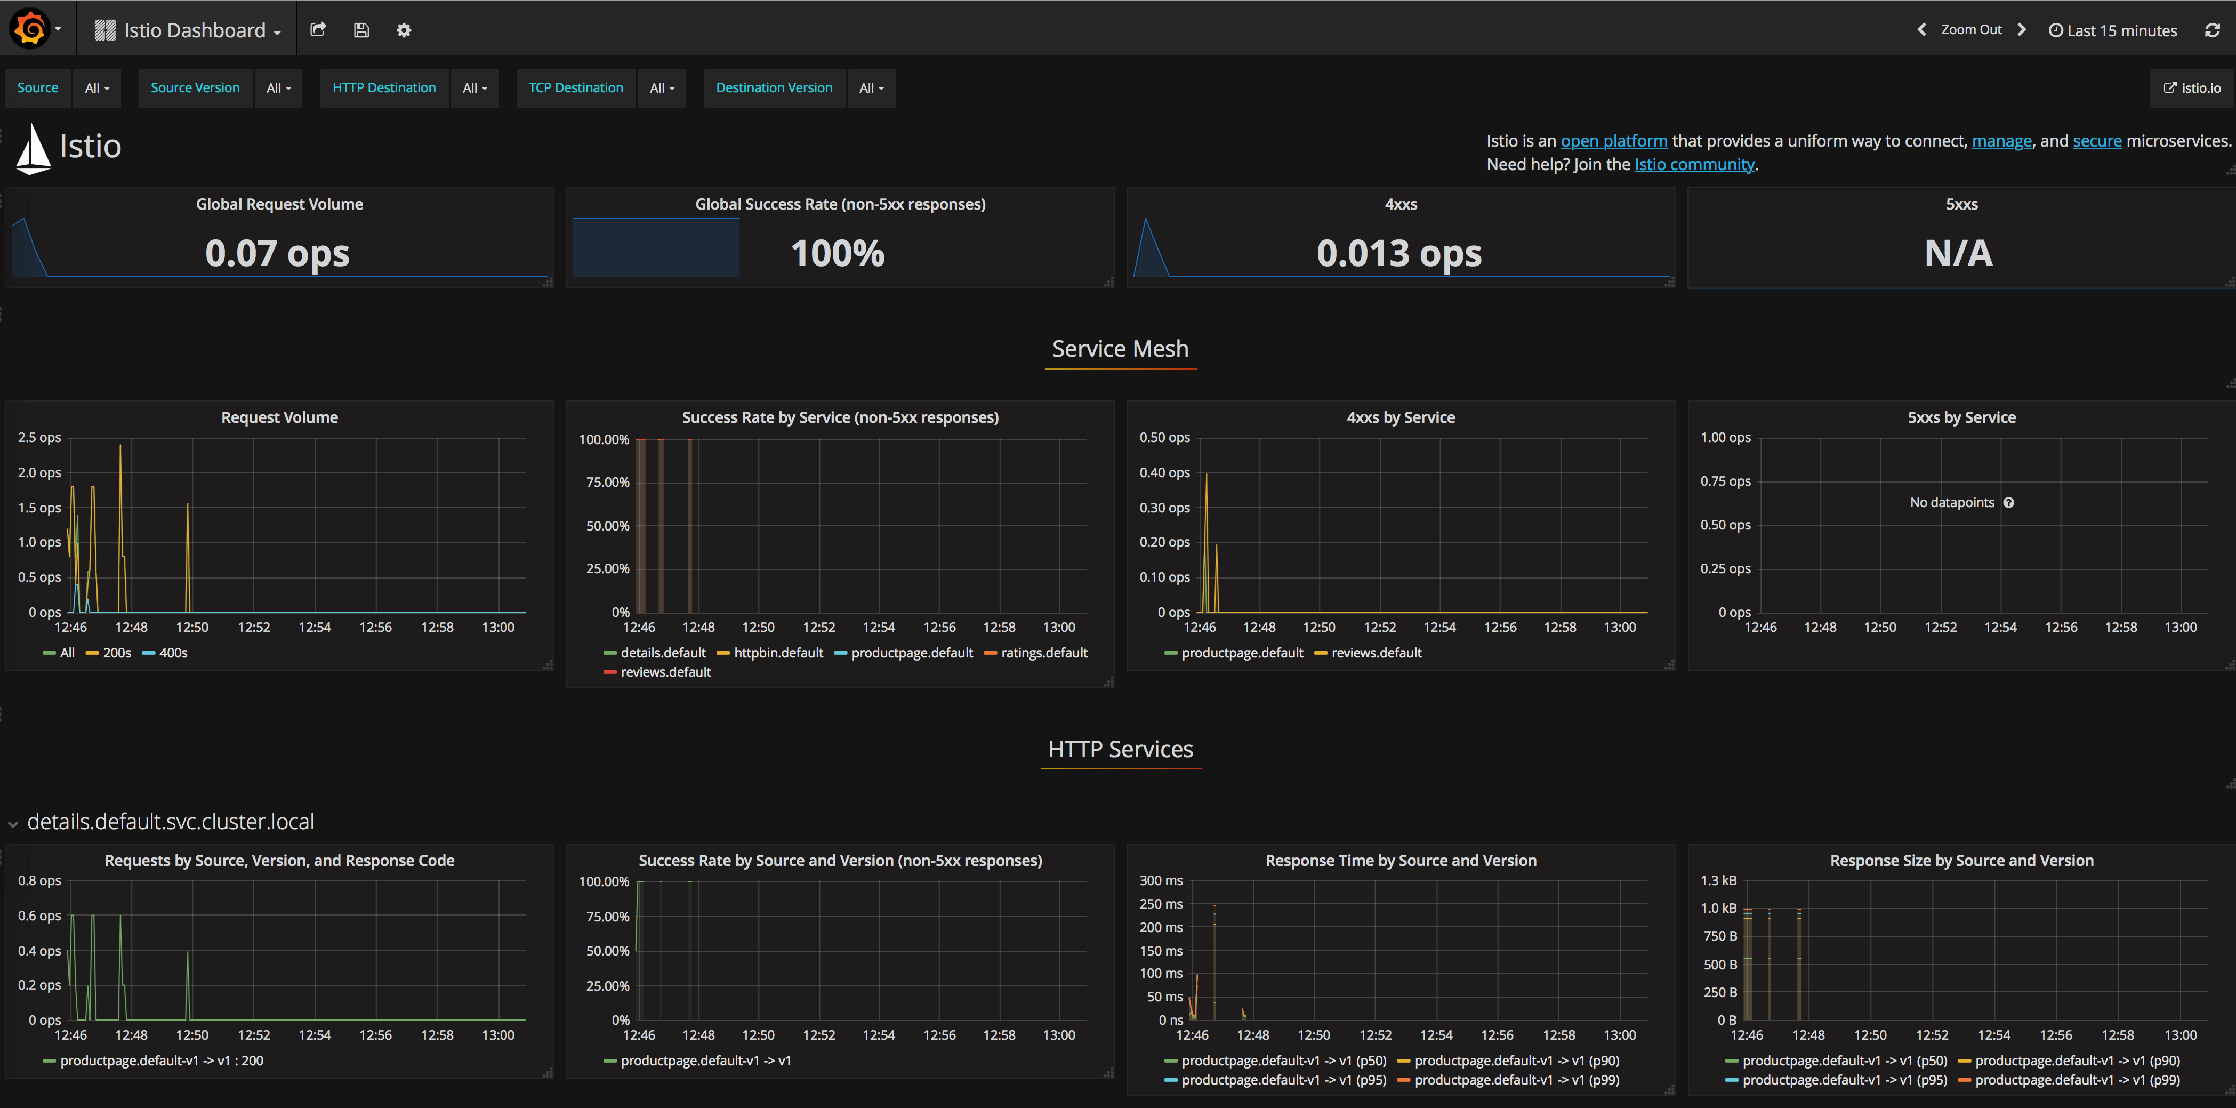
Istio Metrics
Notes:
Automatic Protocol Metrics Collection & Tracing
Instead of creating arbitrary charts for each of your services, you can rely on Istio to collect metrics as requests flow between your services
This allows you to view all your applications as if it was one
The metrics expose global success or failure rates
You can see generally which services are causing the latency to spike

Slide 19


Security
Service
1
Service
2
Notes:
When your application is beyond simple demo purposes, you have to start thinking about how to securely communicate between many services
Many times security and TLS communication becomes and afterthought and has to be bolted on later
Security sometimes feels like IPv6… it’s really important that we adopt that, but it’s probably a next year thing

Slide 20
Istio & Spiffe
Service 1
Service 2
SAN: "spiffe://myorg.com/ns/prod/sa/foo"
- Namespace: prod
- Service account: foo
SAN: "spiffe://myorg.com/ns/prod/sa/bar"
- Namespace: prod
- Service account: bar
Istio Certificate Authority
Issue &
Mount Keys
Issue &
Mount Keys
Notes:
Istio’s certificate authority handles provisioning certificates automatically to communicate between services
This means that I no longer have to store my laptop generated keys in source control and then make sure that I tell everyone to mount in my secrets directory before they start communicating with me
Istio leverages Spiffe to generate a unique identity for each service
These keys and identities are mounted into the given service instances as secrets

Slide 21
Istio & Spiffe
Service 1
Service 2
Mutual TLS & Secure Naming
SAN: "spiffe://myorg.com/ns/prod/sa/foo"
- Namespace: prod
- Service account: foo
SAN: "spiffe://myorg.com/ns/prod/sa/bar"
- Namespace: prod
- Service account: bar
Istio Certificate Authority
Notes:
Because I know that I am part of the myorg domain, I can easily establish TLS-secured connections with other services within myorg
Istio will also take care of rotating and distributing unique keys on a regular interval without any changes to my deployment

Slide 22
Putting it all together
Service 1
Service 2
Envoy
Envoy
Istio Control Plane
Pilot
Mixer
Istio Certificate Authority

Slide 23
Istio Key Features
Automatic Protocol Metrics Collection & Tracing
Mutual TLS Authentication
Circuit Breaking
Failure Injection
Traffic Splitting

Slide 24
RouteRules for Traffic Management
apiVersion: config.istio.io/v1alpha2
kind: RouteRule
metadata:
name: reviews-ios
spec:
destination:
name: reviews-ios
match:
request:
headers:
user-agent:
regex: (iPod|iPhone|iPad)
precedence: 2
route:
- labels:
platform: ios
---
apiVersion: config.istio.io/v1alpha2
kind: RouteRule
metadata:
name: reviews-android
spec:
destination:
name: reviews-android
match:
request:
headers:
user-agent:
regex: (Android)
precedence: 2
route:
- labels:
platform: android
apiVersion: config.istio.io/v1alpha2
kind: RouteRule
metadata:
name: reviews-v2-launch
namespace: default
spec:
destination:
name: reviews
route:
- labels:
version: v2
weight: 25
- labels:
version: v1
weight: 75
Notes:
Traffic Management
Istio RouteRules allow developers to direct traffic to specific services based on metrics like percentiles of requests or matches on HTTP headers
In example on the left we see that 75% of requests for the morganweb application will route to v1 of our service and 25% will route to our new v2 service
To the right we are searching for headers that match mobile backends to user-agents indicating Android or iOS
In the mobile example we can also see a precedence field
RouteRules can be stacked via precedence fields so that you can create default rules and layer additional filters atop

Slide 25
Demo: Dynamic Header Routing
Notes:
Let’s demo the header matching feature by launching a new feature for our Jason user only
Refer to DEMO.md

Slide 26
Circuit breaking
apiVersion: config.istio.io/v1alpha2
kind: DestinationPolicy
metadata:
name: httpbin-circuit-breaker
spec:
destination:
name: httpbin
labels:
version: v1
circuitBreaker:
- simpleCb:
# Maximum number of connection on destination backend
maxConnections: 1
# Maximum number of pending requests to destination backend
httpMaxPendingRequests: 1
# Minimum time circuit will be opened
sleepWindow: 3m
# Time between ejection sweep analysis
httpDetectionInterval: 1s
# Maximum percentage of hosts to eject if circuit is triggered
httpMaxEjectionPercent: 100
# Number of 5XX codes before circuit should be opened
httpConsecutiveErrors: 1
# Max number of requests per connection to a backend
httpMaxRequestsPerConnection: 1
Notes:
In our example production scenario we felt the effects of having multiple services calling out to many other services
In the event that our service is failing, we don’t want to need to shout across the room to tell everyone to stop calling our broken service
Oftentimes downstream services will continue to call your service which may increase the pressure on your already dying service
Istio helps to mitigate this by leveraging policies that force a client to 503 with a circuit-breaker and then retry later with exponential backoff
The retry policy would need to be higher than our sleep window if the circuit-breaker remains tripped
Because a circuit-breaker is designed to protect our service, client overrides are meant to be minimal for the circuit-breaker to be useful

Slide 27
Demo Circuit-Breaking
Notes:
Let’s demo this behavior with an example (refer to demo.md)

Slide 28
Fault injection
apiVersion: config.istio.io/v1alpha2
kind: RouteRule
metadata:
name: ratings-default
spec:
destination:
name: ratings
route:
- labels:
version: v1
httpFault:
delay:
percent: 100
fixedDelay: 2s
apiVersion: config.istio.io/v1alpha2
kind: RouteRule
metadata:
name: reviews-default
spec:
destination:
name: reviews
route:
- labels:
version: v2
httpReqTimeout:
simpleTimeout:
timeout: 1s
Notes:
Failure Injection
Ever wondered what happens to your service when one of your dependencies fails?
Istio enables developers to inject latency to simulate network chattiness
You can then set timeouts on other services that are below your simulated latency
This combination will demonstrate what happens to your service when there is consistent latency and what happens if that latency is over the expected request time that your dependencies have set

Slide 29
Pod
Pod
reviews
ratings
Envoy
Envoy
2 sec latency
Notes:
Because Envoy will trap the request client-side, all requests for ratings will be trapped in the reviews Envoy for 2 seconds

Slide 30
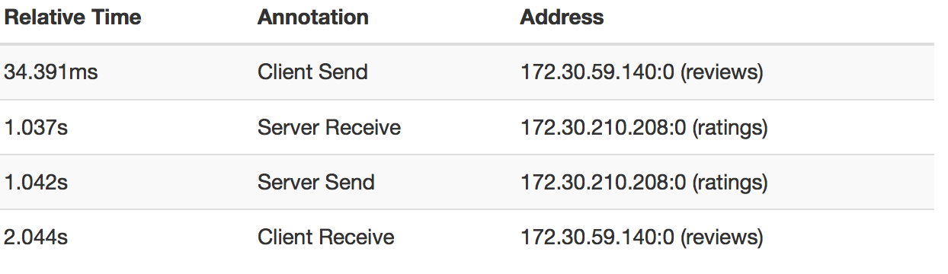
2 second latency trace
Notes:
Productpage finishes it’s request to reviews quickly, but we see the reviews application taking 2 seconds to complete it’s request to the ratings service

Slide 31
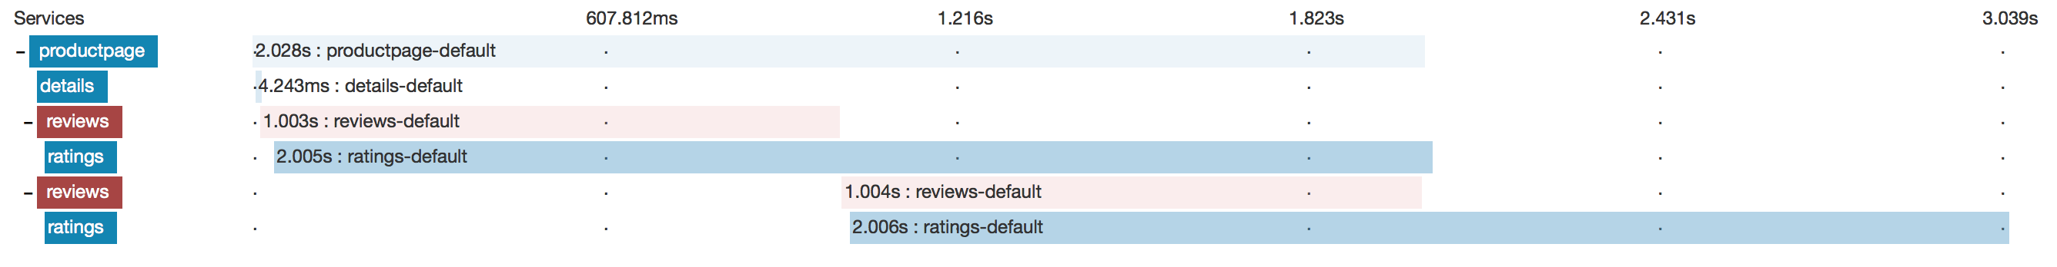
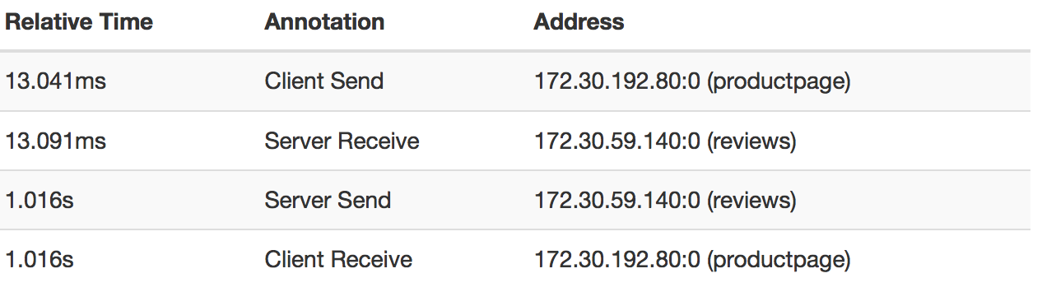
2 second latency with 1 sec timeout
Notes:
When we introduce the 1 second timeout for the reviews service, we see a response fairly quickly, but we end with a 503 status code
We see that calls to the ratings service surpass the response time that reviews needs to complete in and we see a ”reviews service failed message” on the product page

Slide 32
Demo: Failure Injection

Slide 33
FIN: Questions?

